Slide 1
GoF Strategy Pattern
ST3ITS3

Slide 2

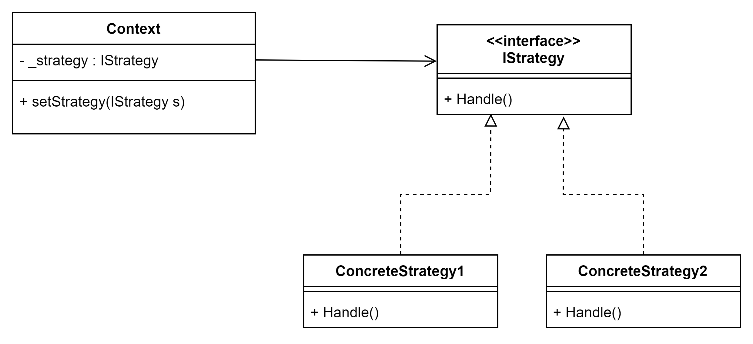
GoF Strategy
Pattern name: Strategy
Intent: Define a family of algorithms, encapsulate each one, and make them interchange- able. Structure:

Slide 3
GoF Strategy
The Strategy pattern enables the behaviour of the context’s be defined at runtime by delegating it to another object.
Use Strategy e.g. when behavior varies at runtime
Moves likely-to-change behavior from the context to a separate class
Easy to add new behavior
Easy to configure behavior runtime

Slide 4
GoF Strategy: discussion
Consider a Hospital Bed
How could you make alarming configurable using GoF Strategy?
Buzzer, lights, email caretakers, ...
Could you also make the filtering configurable using GoF Strategy?
No filtering, noise/debounce filtering, …
How does GoF Strategy relate to the Open-Closed Principle and the Single Responsibility Principle?
GoF Strategy: Define a family of algorithms, encapsulate each one, and make them interchangeable

